Slide 1

Prevention of Domestic Violence

Slide 2
Primary Prevention
Secondary Prevention
Tertiary Prevention

Slide 3


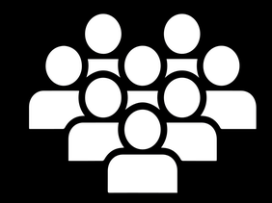
Levels of Domestic Violence Prevention
Τertiary Prevention
Secondary Prevention
High risk
individuals or families
Primary Prevention
General population

Slide 4
Primary Prevention

Slide 5

Where does the problem come from?
Primary Prevention
How could we prevent this at the beggining?
2min

Slide 6

Primary Prevention Framework
of Domestic Violence
Define the domestic violence
Identify risk and protective factors
Develop prevention strategies
Assure widespred adoption
1
2
3
4

Slide 7
Primary prevention goals
Community members
Provision of knowledge and skills development
Change of attitudes and behaviors
Prevention of
violence
Primary prevention strategies

Slide 8
Parent or Caregiver factors
Family factors
Primary Prevention Strategies
Individual factors
Societal & Community Factors
Primary Prevention Strategies

Slide 9
Primary Prevention Strategies
Intimate partners violence
Violence against children
Violence against the elderly

Slide 10
Relationship skills strengthened
Empowerment of women
Services ensured
Poverty reduced
Environments made safe
Child and adolescent abuse prevented
Transformed attitudes, beliefs, and norms
R
E
S
P
E
C
T

Slide 11
Implementation and enforcement of laws
Norms and values
Safe environments
Parent and caregiver support
Income and economic strengthening
Response and support services
Education and life skills
I
N
S
P
I
R
E

Slide 12
Primary Prevention of Elder Abuse
Public and professional awareness campaigns
School-based intergenerational programs

Slide 13
Secondary Prevention

Slide 14
Secondary prevention goals
Early warning & intervention
Identification of risk factors
OR
Abusive behaviour
De-escalation & Conflict management
Effective planning

Slide 15

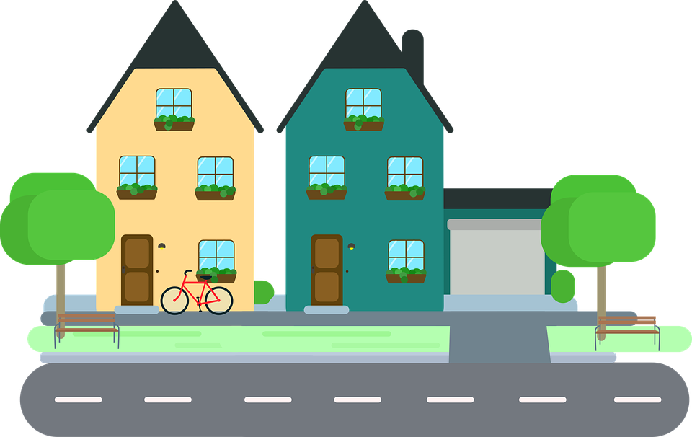
Secondary prevention programmes
Neighborhoods
Communities

Slide 16
Screening programmes
Support & Referrals
Reduce future victimization
&
Prevent long-term health consequences

Slide 17
Home visiting programmes
People with identified risk factors
Screening for domestic violence

Slide 18
Benefits of Screening
It shows that certain behaviors are abusive and wrong
Creates options and reduces isolation
It shows your willingness to discuss the subject when it is ready
It shows how important you think this issue is
Shows that you care about his/her well-being
Opportunity to educate the patient about the impact of abuse
Ability to provide referrals & support
Reduces misdiagnosis
Reduces morbidity and mortality due to abuse
Improves children's lives at home
Provides an opportunity to break the family abuse cycle

Slide 19
Secondary prevention programmes of violence against children
Education Programs for young parents
Home visiting programs for expecting and new mothers
Respite care for families that have children with special needs
Support programs for low-income populations
Caregiver support interventions

Slide 20
Tertiary Prevention

Slide 21
Tertiary Prevention
Survivors
Timely & Appropriate services
Monitoring
All services
Perpetrators

Slide 22

Tertiary Prevention Goals
Reduce the negative consequences
Family
Prevent recurrence

Slide 23
Listen closely, with empathy and no judgement
Inquire about victim’s needs and concerns
Validate victim’s experiences
Enhance their safety
Support the victim to connect with additional services
L
I
V
E
S

Slide 24

Response of professionals in potential domestic violence cases
Safe environment
Identify injuries & other health problems
Treatment
Identify domestic violence
Diagnosis of domestic violence
Reassurance of the victim
Evaluate your emotional state
Take history
Determine the risks and assess safety options
Inform the victim
Determine if legal intervention is needed
Develop a follow-up plan
Offer shelter options, legal services, counseling, and facilitate such referrals

Slide 25

The laws in force and the responsibilities
Competent services

Slide 26
NGO’s & Media

Slide 27
The Role of NGO's
Health & Family well-being programs
Primary health care approach
Collect Information
Provide guidance & awareness
Help Lines
Support

Slide 28
Media campaigns
Posters
TV & radio spots
Public service announcements
Social media’s content
Inform, encourage or warn
Change social norms
Raise issues
Encourage the public
Change perceptions
Prevalence of abuse
Promoting social development
Available resources & choices
Public,
Specific groups or survivors

Slide 29
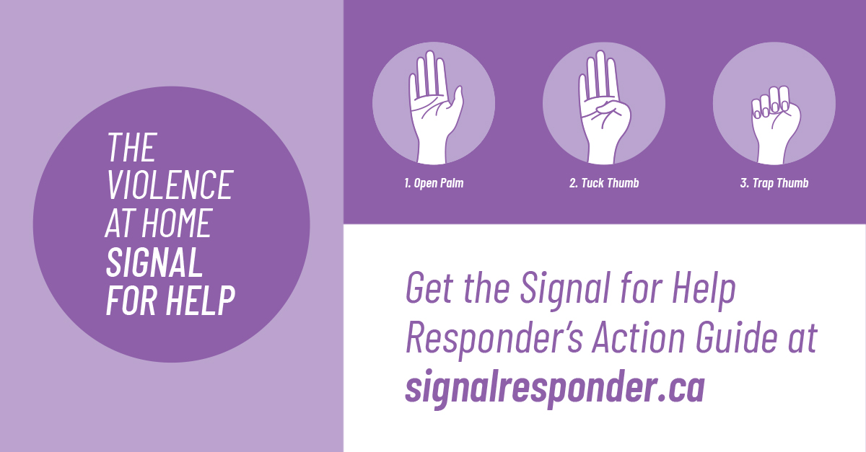

Media Campaigns
Seek similar actions in your country

Slide 30
References
Advocacy in action. (2016). Family preservation services. https://advocacyinaction.casaforchildren.org/cms/wp-content/uploads/2018/11/family-preservation-srvcs-primary-secondary-interventions.pdf
Canadian Women’s Foundation. (n.d.). Signal For Help. https://canadianwomen.org/signal-for-help/
CDC. (2011). The public health approach to violence prevention. https://www.cdc.gov/violenceprevention/pdf/ph_app_violence-a.pdf
CDC. (2016). Picture of America prevention. https://www.cdc.gov/pictureofamerica/pdfs/picture_of_america_prevention.pdf
Child Welfare Information Gateway. (2017). Framework for Prevention of Child Maltreatment. https://www.childwelfare.gov/topics/preventing/overview/framework/#one
Daniel J. Whitaker & Charlene K. Baker. (2007). Interventions to Prevent Intimate Partner Violence. In Handbook of Injury and Violence Prevention (pp. 203-221). Springer. doi:10.1007/978-0-387-29457-5_11
Geethanjali R. & Prabhakar K.. (2013). NGOs Role in Domestic Violence among the Infertility Women in Prakasam District. International Journal of Social Science Tomorrow.
Fábián, K. (2017). The Politics of Domestic Violence in Central Europe: International and Domestic Contestations. In Global Responses to Domestic Violence (pp. 125–149). Springer.
Huecker MR, King KC, Jordan GA, et al. (2022). Domestic Violence. StatPearls.
Irogue, E. J. . (2020). The Role Of NGOs In Managing Domestic Violence In Sub-Saharan Africa: The Case Of Nigeria. AHBV Akdeniz Havzası ve Afrika Medeniyetleri Dergisi, pp. 70-97.
Kirk et al. (2017). Effectiveness of secondary and tertiary prevention for violence against women in ow and low-middle income countries: a systematic review. BMC Public Health. doi: DOI 10.1186/s12889-017-4502-6

Slide 31
References
MCADSV. (2012). Embracing prevention as social change. http://www.calcasa.org/wp-content/uploads/2012/04/embracing-prevention-as-social-change-how-to-build-organizational-capacity-for-prevention.pdf
Stanford.(n.d.). Domestic Abuse. https://domesticabuse.stanford.edu/screening/why.html
UK Faculty of Public Health. (2018). The role of public health in the prevention of violence. https://www.fph.org.uk/media/1381/the-role-of-public-health-in-the-prevention-of-violence.pdf
VAWnet. (2008). A Prevention Primer for Domestic Violence: Terminology, Tools, and the Public Health Approach. https://nnedv.org/wpcontent/uploads/2019/05/Prevention-Primer-for-Domestic-Violence.pdf
VAWnet. (n.d.). Domestic Violence Awareness Project. Retrieved from https://www.dvawareness.org/campaigns
WHO. (n.d.). Elder abuse. https://www.who.int/health-topics/elder-abuse#tab=tab_2
WHO. (2008). Primary prevention of intimate-partner violence and sexual violence. http://www.ndhealth.gov/injury/nd_prevention_tool_kit/docs/who-primary-prevention-of-intimate-partner-violence-and-sexual-violence.pdf
WHO. (2016). INSPIRE: Seven strategies for Ending Violence Against Children. https://www.who.int/publications/i/item/inspire-seven-strategies-for-ending-violence-against-children
WHO. (2019). RESPECT women – Preventing violence against women. https://www.who.int/publications/i/item/WHO-RHR-18.19
WHO. (2020). Coronavirus disease (COVID-19): Violence against women. https://www.who.int/emergencies/diseases/novel-coronavirus-2019/question-and-answers-hub/q-a-detail/coronavirus-disease-covid-19-violence-against-women

Slide 32
Image credits: https://pixabay.com/el/

